Slide 1

Big data on Hadoop
Presented by -Bheemidi Vikram Reddy
Notes:
NOTE: Want a different image on this slide? Select the picture and delete it. Now click the Pictures icon in the placeholder to insert your own image.

Slide 2
What is Data? And its importance ?
Data is a collection of records which are collected during operations of business.
Data is accurate, timely and specific
Data can exist in a variety of forms — as numbers or text on pieces of paper, as bits and bytes stored in electronic memory. Since the mid-1900s data is generated

Slide 3
From where this data comes from:
These data come from many sources like
  Social networking sites: Facebook, Google, LinkedIn all these sites generates huge amount of data on a day to day basis as they have billions of users worldwide.
  E-commerce site: Sites like Amazon, Flipkart, Alibaba generates huge amount of logs from which users buying trends can be traced.
  Weather Station: All the weather station and satellite gives very huge data which are stored and manipulated to forecast weather.
  Telecom company: Telecom giants like Airtel, Vodafone study the user trends and accordingly publish their plans and for this they store the data of its million users.
  Share Market: Stock exchange across the world generates huge amount of data through its daily transaction.

Slide 4
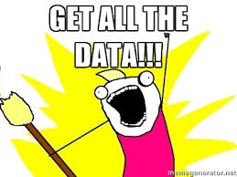
What is big data is big deal ?
Big Data:
In simple words, Big Data is a Problem statement. Any data which has large variety of data(images, videos, files etc), And comes in with very high rate and in huge volumes is Big data.

Slide 5
Characteristics of Big Data
The FOUR V's of Big Data
Velocity – Denotes the speed at which data is emanating and changes are occurring between the diverse data sets.
Volume – Around 6 million people are using the digital media and it is estimated that about 2.5 quintillion bytes of data is being generated every day.
Variety – Most of the data is unstructured in nature.
Veracity – 27% of businesses are not sure if the data they are working on is accurate.
Value
VALUE

Slide 6

Big Data Analytics (VALUE)
  Value – extracting business logic from the above characteristics is the real definition for the big data.

Slide 7
Data exchange for every "1" minute
204 million+ emails sent
100,000+ tweets
2 million+ Google searches
$275,000 spent online shopping
35,000 brand 'Likes' on Facebook
38,000 new Tumbler blog posts
48 hours of new video on YouTube

Slide 8
Difference between Structured Data & Unstructured Data
Structured Data
Unstructured Data
Found in databases that is organized in a way that lets users select exact pieces, rows or columns of that database
Has no such architecture and can often include e-mail messages, documents files, text from social networks, image data, audio & video data.

Slide 9
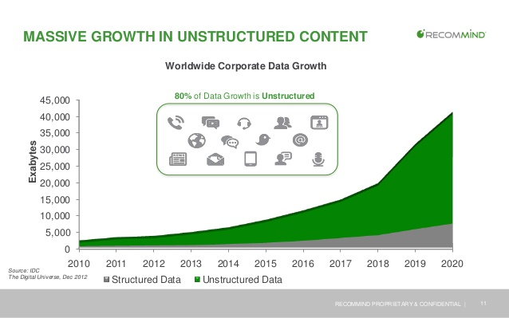
The reason behind Big Data over RDBMS

Slide 10

What is Hadoop ?
Hadoop is an open source, Java-based programming framework that supports the processing and storage of extremely large data sets in a distributed computing environment. It is part of the Apache project sponsored by the Apache Software Foundation.

Slide 11
Advantages of Hadoop
Ability to store and process huge amounts of any kind of data, quickly. With data volumes and varieties constantly increasing, especially from social media and the Internet of Things (IoT), that's a key consideration.
Computing power. Hadoop's distributed computing model processes big data fast. The more computing nodes you use, the more processing power you have.
Fault tolerance. Data and application processing are protected against hardware failure. If a node goes down, jobs are automatically redirected to other nodes to make sure the distributed computing does not fail. Multiple copies of all data are stored automatically.
Flexibility. Unlike traditional relational databases, you don’t have to preprocess data before storing it. You can store as much data as you want and decide how to use it later. That includes unstructured data like text, images and videos.
Low cost. The open-source framework is free and uses commodity hardware to store large quantities of data.
Scalability. You can easily grow your system to handle more data simply by adding nodes. Little administration is required.

Slide 12
Main components of Hadoop 2.X
Hadoop Distributed File System – HDFS, it is primarily a file system similar to many of the already existing ones. However, it is also a virtual file system.
There is one notable difference with other popular file systems, which is, when we move a file in HDFS, it is automatically split into smaller files. These smaller files are then replicated on a minimum of three different servers
YARN - Yet Another Resource Manager takes programming to the next level beyond Java, and makes it interactive to let another application Hbase, Spark etc. to work on it. Different Yarn applications can co-exist on the same cluster so MapReduce, Hbase, Spark all can run at the same time bringing great benefits for manageability and cluster utilization.

Slide 13
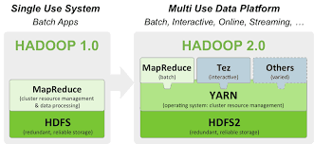
Hadoop ecosystem

Slide 14
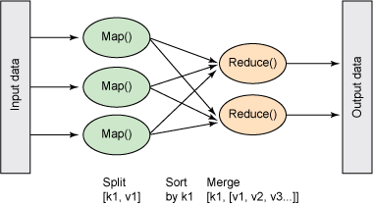
Apache MapReduce
MapReduce is a processing technique and a program model for distributed computing based on java. The MapReduce algorithm contains two important tasks, namely Map and Reduce. Map takes a set of data and converts it into another set of data, where individual elements are broken down into tuples (key/value pairs). Secondly, reduce task, which takes the output from a map as an input and combines those data tuples into a smaller set of tuples. As the sequence of the name MapReduce implies, the reduce task is always performed after the map job.

Slide 15
Apache Hive
Hive is a data warehouse system layer built on Hadoop which allows you to define a structure for your big data and simplifies analysis and queries with an SQL-like scripting language called HiveQL.
Hive uses a database to store metadata, but the data that hive process is stored in hdfs. Simply hive is nothing but which allows to run structured query on unstructured data.

Slide 16
Apache pig
Pig is an in memory processing tool and also said to be data flow language which supports all data formats. In pig we have grunt shell and by default data type will be byte array. Pig provides a high-level language known as Pig Latin.

Slide 17
Components of Hadoop
Apache Flume. A tool used to collect, aggregate and move huge amounts of streaming data into HDFS.
Apache HBase. An open source, non relational, distributed database.
Apache Oozie. A server-based workflow scheduling system to manage Hadoop jobs.
Apache Sqoop. A tool to transfer bulk data between Hadoop and structured data stores, such as relational databases.
Apache Zookeeper. This is basically a centralized system that maintains – Configuration information Naming information Synchronization information.

Slide 18
Introduction to HDFS
Namenode
  NameNode is the centerpiece of HDFS.
  NameNode is also known as the Master
  NameNode only stores the metadata of HDFS – the directory tree of all files in the file system, and tracks the files across the cluster.
  NameNode does not store the actual data or the dataset. The data itself is actually stored in the DataNodes.
Datanode
  DataNode is responsible for storing the actual data in HDFS.
  DataNode is also known as the Slave
  NameNode and DataNode are in constant communication
Secondary Namenode
  Secondary NameNode is a specially dedicated node in HDFS cluster whose main function is to take checkpoints of the file system metadata present on namenode.
  It is not a backup namenode.

Slide 19
Description of project (H1B – Case Study)
The H1B is an employment-based, non-immigrant visa category for temporary foreign workers in the United States.
For a foreign national to apply for H1B visa, an US employer must offer a job and petition for H1B visa with the US immigration department.
This is the most common visa status applied for and held by international students once they complete college/ higher education (Masters, Ph.D.) and work in a full-time position.
We will be performing analysis on the H1B visa applicants between the years 2011-2015
The dataset has nearly 3 million of records.
The dataset is unstructured form.

Slide 20
The columns in the dataset includes
s_no (no of the applicant)
case_status (certified, certified withdrawn, withdrawn, denied)
employer_name (Name of employer submitting labor condition application)
soc_name (the Occupational name associated with the SOC_CODE)
job_title (Title of the job)
full_time_position (Y = Full Time Position; N = Part Time Position)
prevailing_wage (Average wage paid to similarly employed workers
year (Year in which the H1B visa petition was filed)
worksite (City and State information of the foreign worker’s)
longitude (longitude of the Worksite)
latitude (latitude of the Worksite)

Slide 21
Project Analysis
1 a) Is the number of petitions with Data Engineer job title increasing over time?
b) Find top 5 job titles who are having highest avg growth in applications.
2 a) Which part of the US has the most Data Engineer jobs for each year?
b) find top 5 locations in the US who have got certified visa for each year.
3)Which industry(SOC_NAME) has the most number of Data Scientist positions?
4)Which top 5 employers file the most petitions each year? - Case Status - ALL
5) Find the most popular top 10 job positions for H1B visa applications for each year?
a) for all the applications b) for only certified applications.

Slide 22
Cont..
6) Find the percentage and the count of each case status on total applications for each year. Create a line graph depicting the pattern of All the cases over the period of time.
7) Create a bar graph to depict the number of applications for each year
8) Find the average Prevailing Wage for each Job for each Year (take part time and full time separate). Arrange the output in descending order.
9) Which are the employers along with the number of petitions who have the success rate more than 70% in petitions. (total petitions filed more than 1000) ?
10) Which are the job positions along with the number of petitions which have the success rate more than 70% in petitions (total petitions filed more than 1000)?
11) Export result for question no 10 to MySql database.

Slide 23
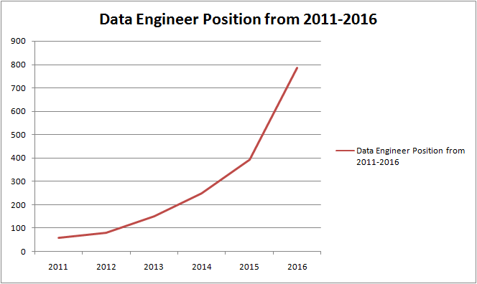
Data Engineering are increasing over time

Slide 24
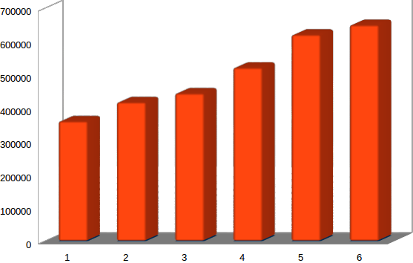
Petitions are increasing over time from 2011-2016

Slide 25
conclusion
The data which is processed by me gives a brief impact on study cases and it gives lot of information to the us immigration department about the petitions, case status like how many number of people are certified, certified withdrawn, withdrawn, denied.

